Slide 1
Bayesian Belief Networks
Bayesian belief network allows a subset of the variables/ attributes to be conditionally independent.
Gives a specification of joint probability distribution.
They provide a graphical model of causal relationships, on which learning can be performed.
Trained Bayesian belief networks can be used for classification
‹#›

Slide 2
Bayesian Belief Networks
A Bayesian network graph is made up of nodes and Arcs (directed links), where:
Each node corresponds to the random variables, and a variable can be continuous or discrete.
Arc or directed arrows represent the causal relationship or conditional probabilities between random variables..These links represent that one node directly influence the other node, and if there is no directed link that means that nodes are independent with each other

Slide 3
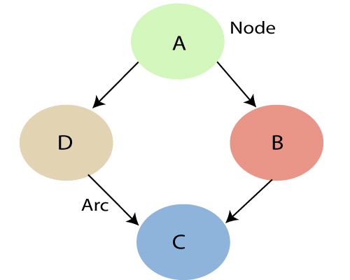
Belief Network Graph
In the diagram, A, B, C, and D are random variables represented by the nodes of the network graph.
If we are considering node B, which is connected with node A by a directed arrow, then node A is called the parent of Node B.
Node C is independent of node A.
The Bayesian network has mainly two components: Causal Component and Actual numbers
Each node in the Bayesian network has conditional probability distribution P(X_{i} |Parent(X_{i}) ), which determines the effect of the parent on that node.
Bayesian network is based on Joint probability distribution and conditional probability.
A belief network is defined by two components—a directed acyclic graph and a set of conditional probability tables

Slide 4
Belief Network Graph
Each node in the Bayesian network has conditional probability distribution P(X_{i} |Parent(X_{i}) ), which determines the effect of the parent on that node.
Bayesian network is based on Joint probability distribution and conditional probability.
A belief network is defined by two components—a directed acyclic graph and a set of conditional probability tables

Slide 5
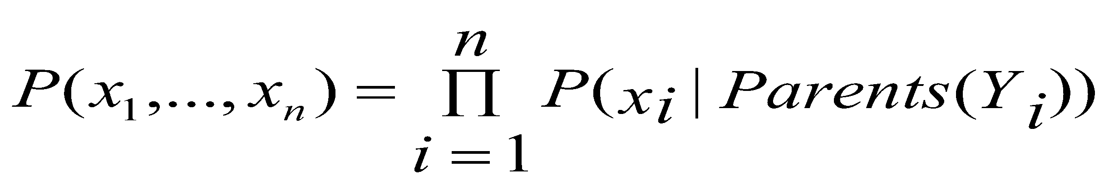
Joint probability distribution:
If we have variables x1, x2, x3,....., xn, then the probabilities of a different combination of x1, x2, x3.. xn, are known as Joint probability distribution.
P[x₁, x₂, x₃,....., x_{n}], can be written in terms of the joint probability distribution as below:
P[x₁, x₂, x₃,....., x_{n}]= P[x₁| x₂, x₃,....., x_{n}]P[x₂, x₃,....., x_{n}]
= P[x₁| x₂, x₃,....., x_{n}]P[x₂|x₃,....., x_{n}]....P[x_{n-1}|x_{n}]P[x_{n}].
In general for each variable Xi, we can write the equation as:
P(X_{i} | X_{i-1},........., X₁) = P(X_{i} |Parents(X_{i}))
X

Slide 6
Example:
Harry installed a new burglar alarm at his home to detect burglary. The alarm reliably responds at detecting a burglary but also responds for minor earthquakes.
Harry has two neighbors David and Sophia, who have taken a responsibility to inform Harry at work when they hear the alarm.
David always calls Harry when he hears the alarm, but sometimes he got confused with the phone ringing and calls at that time too. On the other hand,
Sophia likes to listen to high music, so sometimes she misses to hear the alarm.
Here we would like to compute the probability of Burglary Alarm.
Problem:Calculate the probability that alarm has sounded, but there is neither a burglary, nor an earthquake occurred, and David and Sophia both called the Harry.

Slide 7
List of all events occurring in this network:
Burglary (B)
Earthquake(E)
Alarm(A)
David Calls(D)
Sophia calls(S)

Slide 8
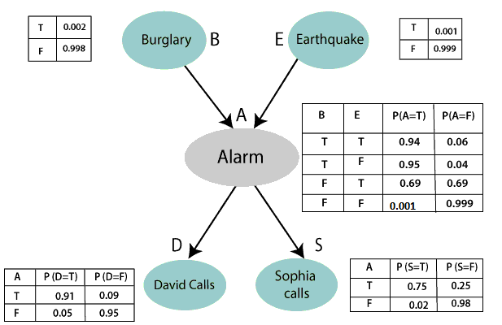
Belief Network
0.05
0.31
0.001

Slide 9
Problem:Calculate the probability that alarm has sounded, but there is neither a burglary, nor an earthquake occurred, and David and Sophia both called the Harry.
From the formula of joint distribution , write the problem statement in the form of probability distribution:
P(S, D, A, ¬B, ¬E) = P (S|A) *P (D|A)*P (A|¬B ^ ¬E) *P (¬B) *P (¬E).
= 0.75* 0.91* 0.001* 0.998*0.999
= 0.00068045.
Hence, a Bayesian network can answer any query about the domain by using Joint distribution.

